Slide 1
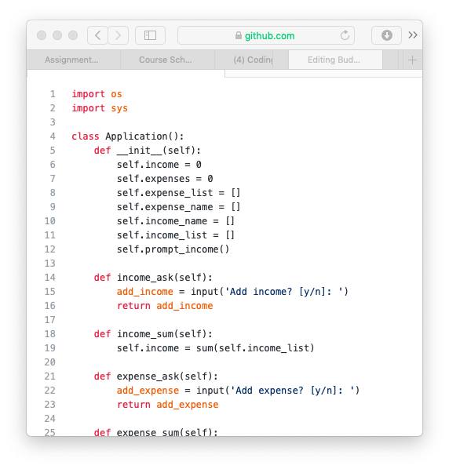
Expense Tracker
By Connor Mediate
The Expense Tracker Calculates all my monthly expenses
It will track my insurance, cost of tuition, gas, rent, food, and health supplies
The Code will be imported from OS and SYS

